Slide 1
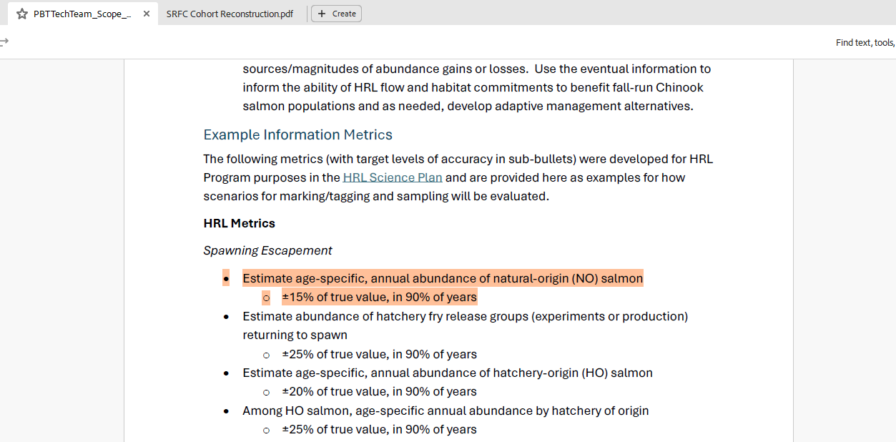

Slide 2
Sampling Questions
Sample Size: How many scales do we need to sample from recovered fish to accurately estimate the proportion of age classes in natural origin fish?
Sample Pooling: Instead of collecting some minimum number of samples from each tributary and hatchery, what if we just pooled samples across the Sacramento River basin to produce a single cohort reconstruction (CR) value? What is lost by doing this? What are the assumptions and what happens if we violate them?

Slide 3
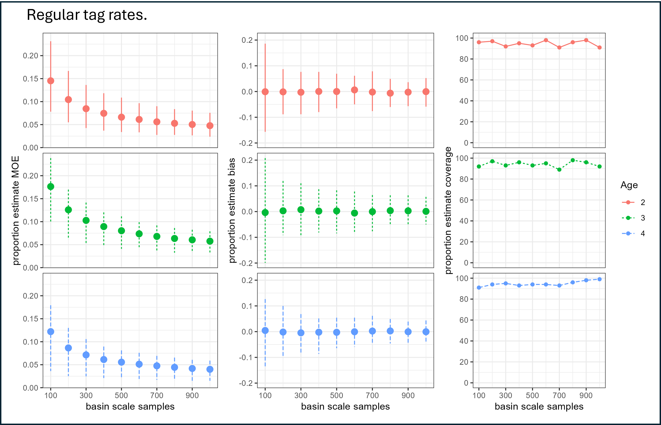
Notes:
Running a bunch of different simulations using this method, I found that 500 scales is a good minimum that provides an unbiased estimate within a 10% margin of error that accurately includes the true values around 95% of the time.
Proportion estimate coverage = in what proportion of our simulations was the true value within the estimated confidence intervals?

Slide 4

The good news?
The math and methods is the same, ${\hat{p}}_{no,a}$ is derived from ${\hat{N}}_{no,a}$
$${\hat{p}}_{no,a}=\frac{{\hat{N}}_{no,a}}{{\hat{N}}_{no}}$$

Slide 5

The bad news?
Currently our decision on the number of scales to collect comes from accuracy metrics of ${\hat{p}}_{no,a}$ not ${\hat{N}}_{no,a}$.
${\hat{p}}_{no,a}$ is ambivalent to the size of ${\hat{N}}_{no}$

Slide 6
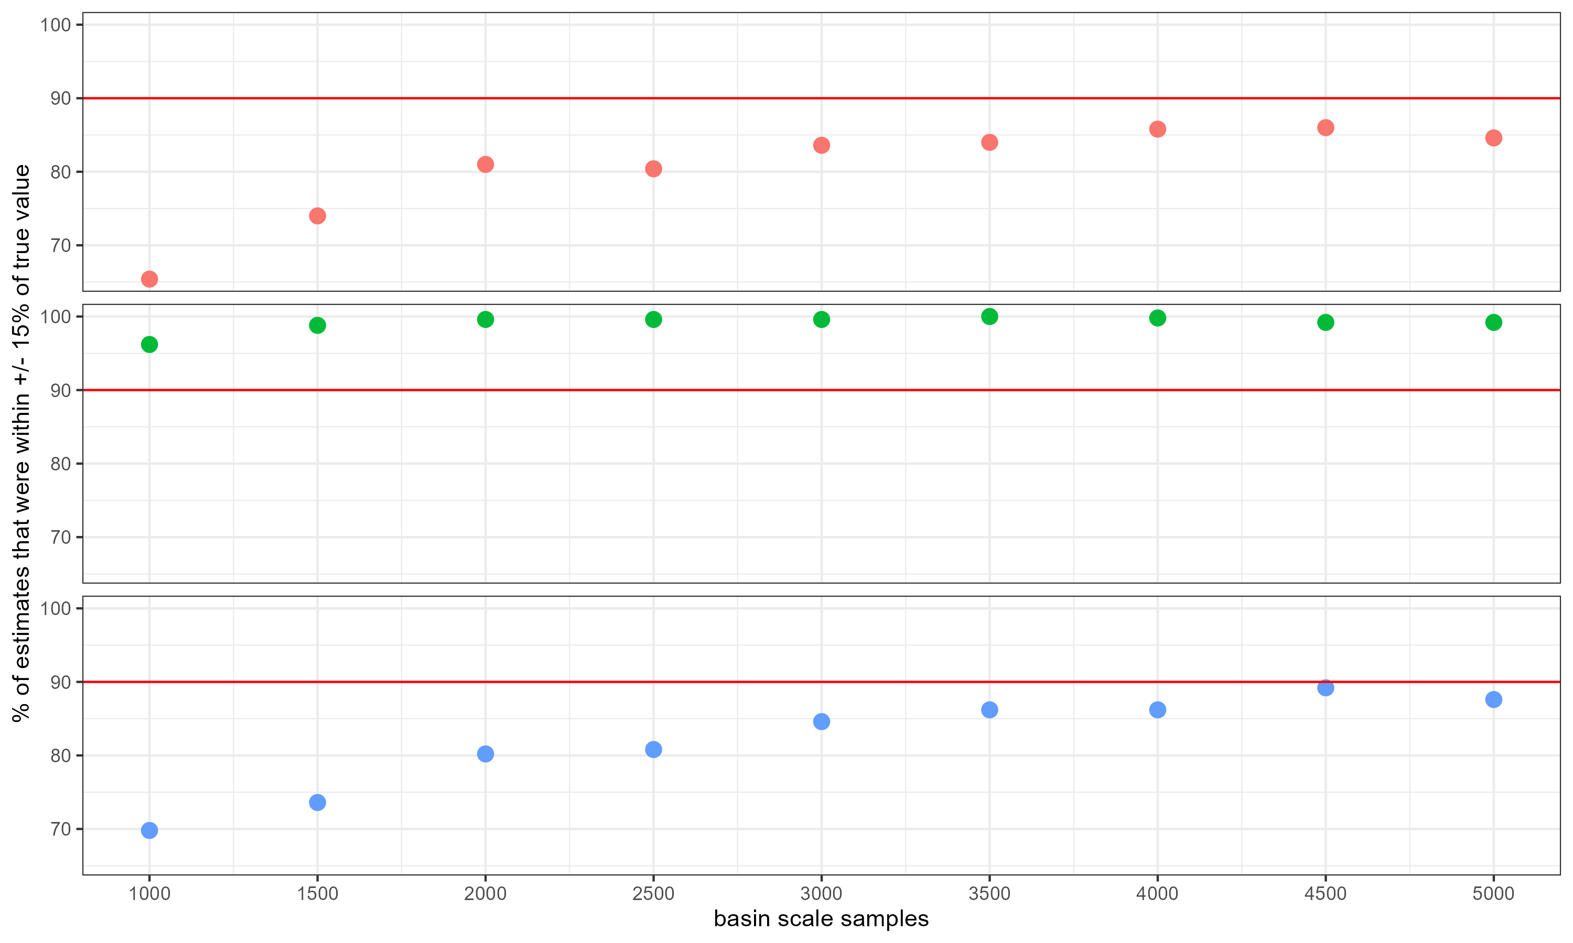
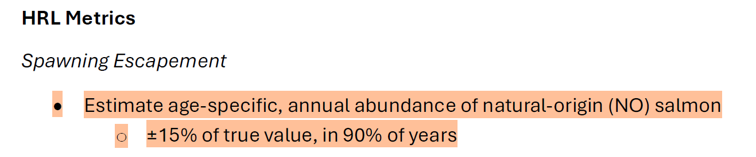
Scale sample size does very little for our accuracy of ${\hat{N}}_{no,a}$

Slide 7
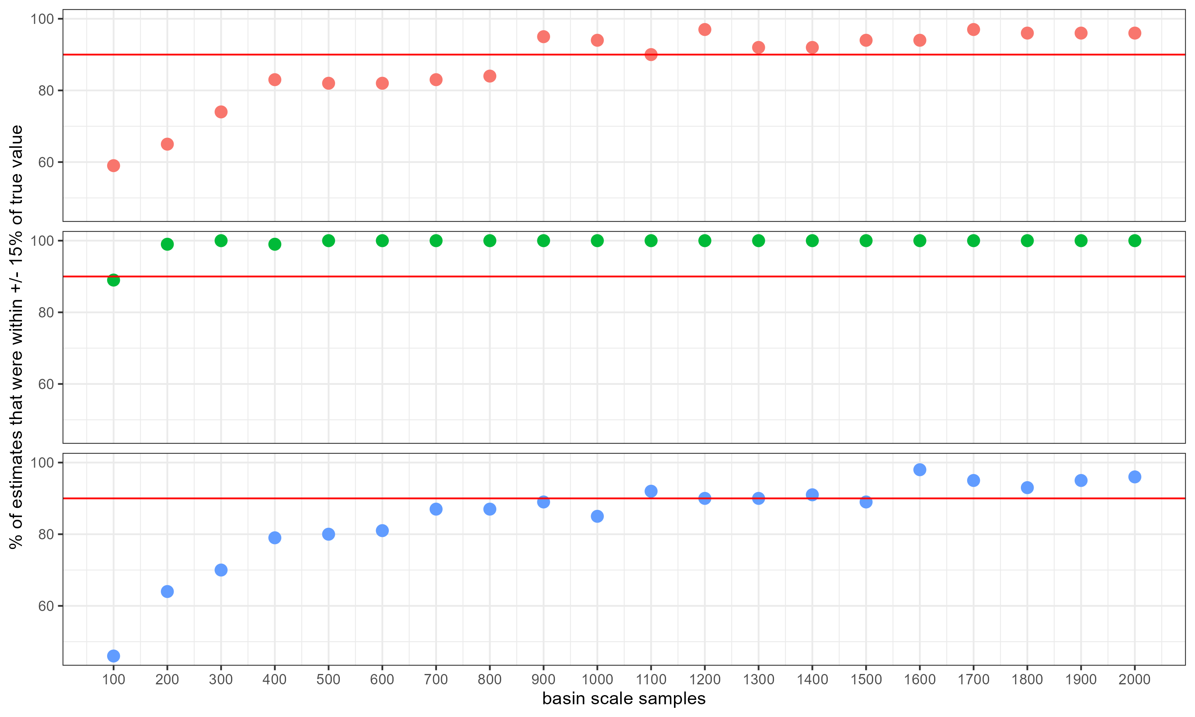
But if we set tag-rate to 100%:

Slide 8

Conclusion
If we our target metric is ${\hat{p}}_{no,a}$, then no issue!
But, if our target metric was supposed to be ${\hat{N}}_{no,a}$ ±15%, then we should look to incorporate 100% tagging through PBT to get more accurate estimates and increase scale sample size to ~1000 scales.

